Slide 1

Visualization of Large Complex Datasets
Steve Elston
Copyright 2018, 2019, 2020, 2021, 2022, 2023 2024, Stephen F Elston. All rights reserved.

Slide 2
Review: Why is Perception Important?
Goal: Communicate information visually
Good visualization techniques maximize the information a viewer perceives
Limits of human perception are a significant factor in understanding complex relationships
Apply results of research on human perceptions for data visualization

Slide 3
Use Aesthetics to Improve Perception
Use aesthetics to improve perception
Take a very broad view of the term ‘aesthetic’
A plot aesthetics is any property of a visualization which highlight aspects of the data relationships
Aesthetics are used to project additional dimensions of complex data onto the 2-dimensional plot surface

Slide 4
Regression Lines
Regression lines draw viewers attention
Typically use a nonlinear regression line
Polynomial
Splines - piece wise model
Lowess - local nonlinear regression
Bootstrap confidence intervals show range of probable trends
More on bootstrap resampling later
Ideally want strait line relationship
Nonlinear relationships often arise from non-Normal distributions
Linear relationship is more intuitive

Slide 5
Properties of Common Aesthetics
Property or Aesthetic | Perception | Data Types
Aspect ratio | Good | Numeric
Regression lines | Good | Numeric plus categorical
Marker position | Good | Numeric
Bar length | Good | Counts, numeric
Sequential color palette | Moderate | Numeric, ordered categorical
Marker size | Moderate | Numeric, ordered categorical
Line types | Limited | Categorical
Qualitative color palette | Limited | Categorical
Marker shape | Limited | Categorical
Area | Limited | Numeric or categorical
Angle | Limited | Numeric

Slide 6
Visualizing Large Complex Data is Difficult
Problem: Modern data sets are growing in size and complexity
Goal: Understand key relationships in large complex data sets
Difficulty: Large data volume
Modern computational systems have massive capacity
Example: Use map-reduce algorithms on cloud clusters
Difficulty: Large numbers of variables
Numerous variables with many potential relationships
This is the hard part!
Note: we will address use of dimensionality reduction techniques in another lesson, time permitting

Slide 7
Visualizing Large Complex Datasets
Important note!!
I expect you to use the appropriate methodology for visualizing complex relationships in your project!!

Slide 8
Limitation of Scientific Graphics
All scientific graphics are limited to a 2-dimensional projection
But, complex data sets have a great many dimensions
We need methods to project large complex data onto 2-dimensions
Generally, multiple views are required to understand complex data sets
Don’t expect one view to show all important relationship
Develop understanding over many views
Try many views, don’t expect most to be very useful

Slide 9
Approaches to display of complex data relationships
Combine multiple methods to effectively display complex data
Use plots that inherently scale
Avoid over-plotting to ensure plot is understandable
Choose plot types that do not exhibit overplotting
Use multi-axis plots
Scatter plot matrices
Facet plots
Filter cases using cognositics
Often a creative case specific plot type is a good choice

Slide 10
Scalable Chart Types
Some chart types are inherently scalable
Bar plots: Counts can be efficiently computed; e.g. use map-reduce
Histograms: Data is binned in parallel
Box plots: Finding the quartiles is a scalable counting process
KDE and violin plots: Similarly to the box plot, using kernel density estimation

Slide 11
Over-plotting
Over-plotting occurs in plots when the markers lie one on another.
Common, even in relatively small data sets
Scatter plots can look like a blob and are completely uninterpretable!
Over-plotting is a significant problem in EDA and presentation graphics

Slide 12
Dealing with Over-plotting
What can we do about over-plotting?
Marker transparency: so one can see markers underneath; useful in cases with minimal overlap of markers
Marker size: smaller marker size reduces over-plotting within limits
Adding jitter: adding a bit of random jitter to variables with limited number of values
Random down-sampling: for very large data sets, you may only need a representative sample to understand key data relationships
Use Bernoulli sample, or stratified sample

Slide 13
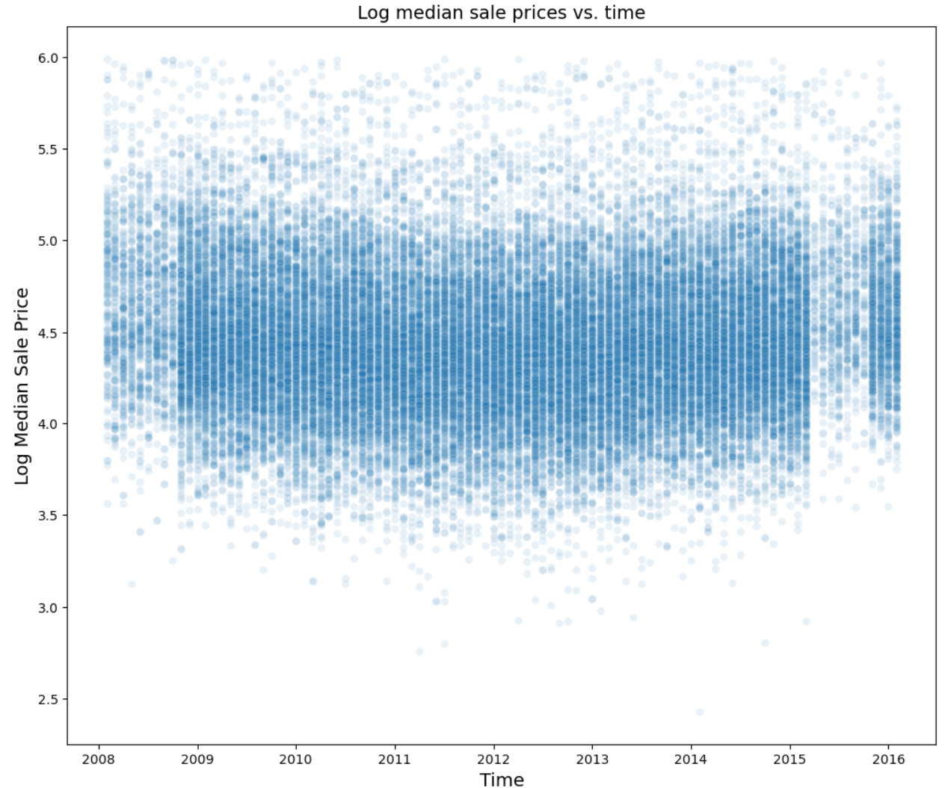
Example of Overplotting
Overplotting arises from high density overlapping markters
Overplotting prevents seeing marker density
Overplotting obscures important information in a plot
Notes:
O

Slide 14
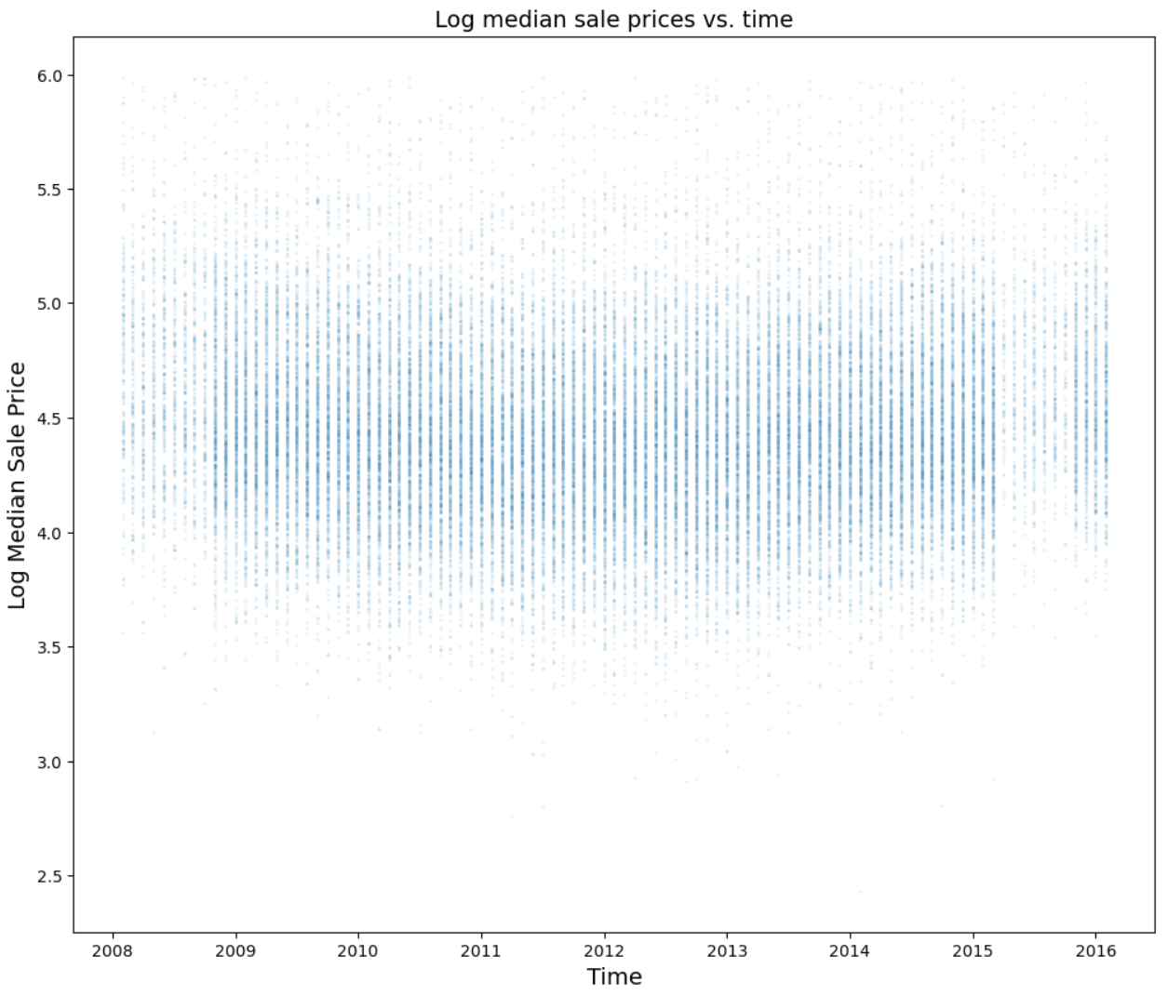
Use Transparency, Marker Size, Down-Sampling
Down sample to 20%, use opacity, alpha = 0.1, market size = 2
Changes in marker density are more apparent
Details in structure of data relationship are evidence

Slide 15
Methods to Display Large Data Sets
Alternatives to avoid over-plotting for truly large data sets
Hex bin plots: the 2-dimensional equivalent of the histogram
Frequency of values is tabulated in 2-dimensional hexagonal bins
Displayed using a sequential color palette
2-d kernel density estimation plots: natural extension of the 1-dimensional KDE plot
Good for moderately large data
Heat map: value of one variable against two others
Categorical (count) or continuous variables
Carefully choose color pallet, sequential or divergent
Mosaic plots: display multidimensional count (categorical) data
Uses tile size and color to project multiple dimensions
2-d equivalent of a multivariate bar chart
Dimensionality reduction: we will not discuss this topic

Slide 16
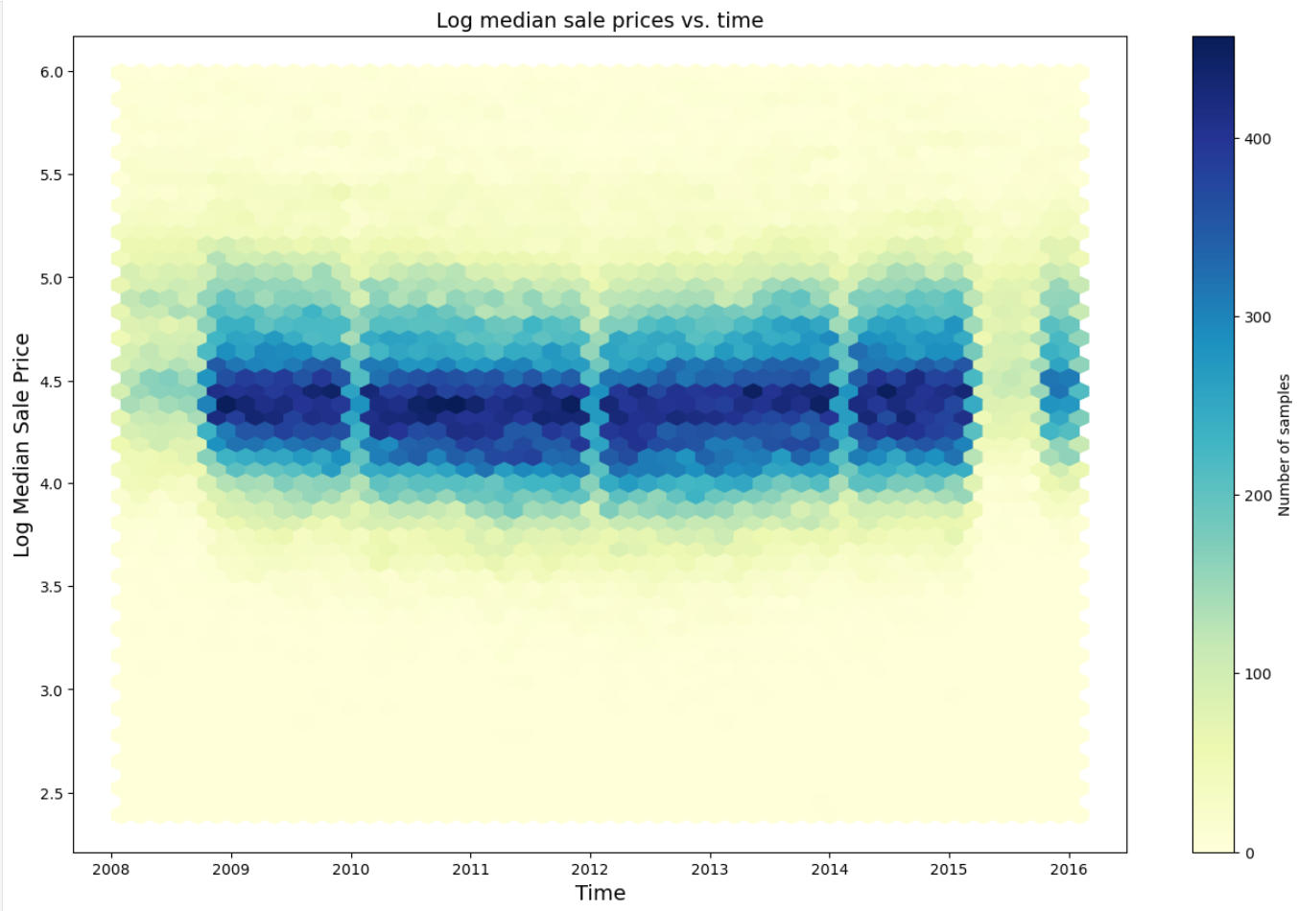
Hexbin Plot
The Hex-Bin plot is a two-dimensional extension of the familiar histogram
Hex-bin plot eliminates overplotting!
Hex-shaped bins minimize directional bias
Hex-binning is computationally efficient and massively scalable
Example: Density of sale price by time shows pattern of price changes

Slide 17
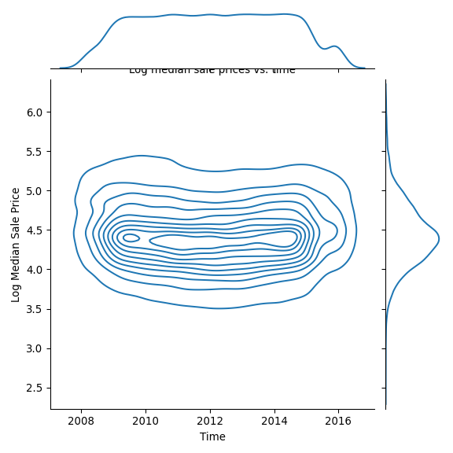
Contour Plot
Contour plot lines show iso-density levels in a 2-d plot
Contour plots outline general relationships between variable
Computing contours can be computationally intensive
Example: Contour plot of 2-D KDE of sale price vs. time shows outline of changing density

Slide 18
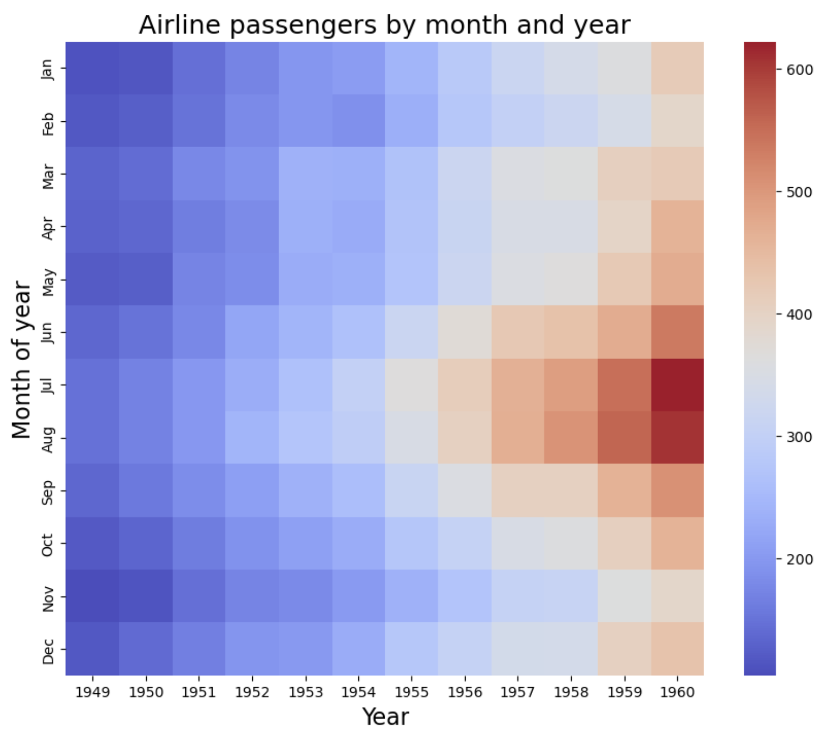
Heat Map
Heat map is a plot of the value of a variable against two others using a sequential color palette
Heat map is effective at showing qualitative relationships
Use of rectangular bins creates directional bias
Binning for heat map is computationally efficient
Example: Airline passenger counts by month and year displayed by sequential heat map
Heat map of monthly airline passengers by year

Slide 19
Mosaic Plots
How can we display multidimensional count (categorical) data at scale?
Mosaic plots displays the relative proportion of counts of a contingency table
Plot area is divided and fully filled by a set of tiles
The larger the count, the larger tile area

Slide 20
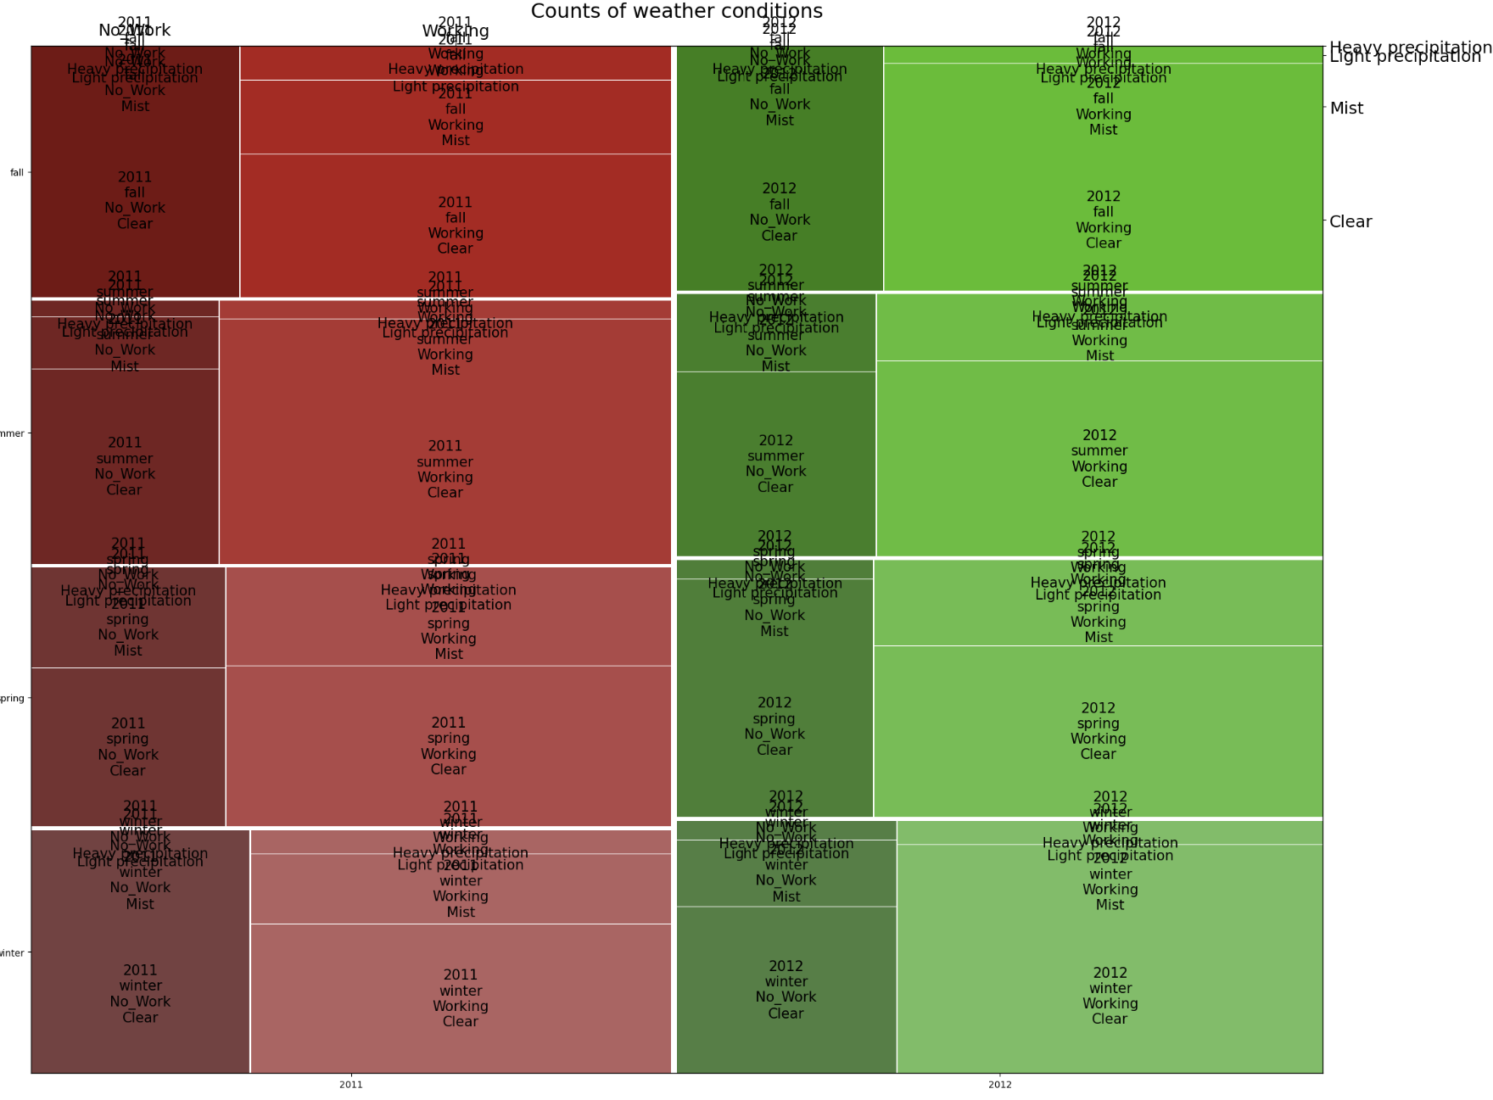
Mosaic Plots
Mosaic plot represents counts of a variable by tile size vs. a number of categorical variables
Computing counts for tile size is computationally efficient
Interpretation of mosaic plots can take some efforts
Example: Daily counts of riders vs. 5 categorical variables, a 6-dimensional projection!
Mosaic plot of daily bike ridership by year, quarter, work-day, wind conditions and precipitation

Slide 21
Other Methods to Display Large Data Sets
Sometimes a creative alternative is best
Often situation specific; many possibilities
Finding a good display for a specific purpose can require significant creativity!
Example, choropleth for multi-dimensional geographic data
Example, time series of box plots

Slide 22
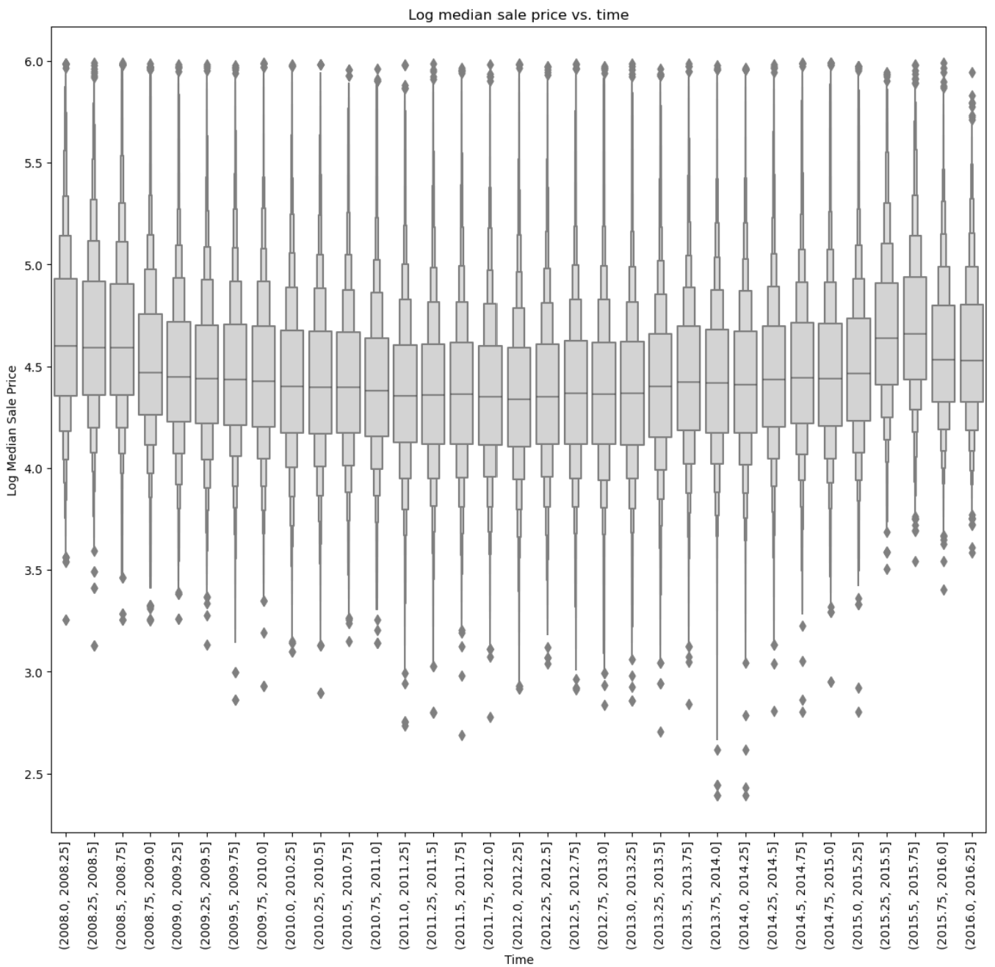
Time Series of Box Plots
Task specific visualizations can illuminate aspects in specific domains
Example: Time ordered box plots of quarterly count of sales prices of homes
Notice the changes of distribution of the variable with time

Slide 23
Displays for Complex Data
How can we understand the relationships in complex high-dimensional data with many variables?
Must confront limitations for 2-dimensional projection inherent in computer graphics
Need methods to scale to higher dimensions
Apply combination of arrays of plots and filtering
Aesthetics: used to increase the number of projected dimensions

Slide 24
Displays for Complex Data
How can we understand the relationships in complex high-dimensional data with many variables?
Arrays of plots: subsets show relationships in a complex data set
Pairwise scatter plots: matrix of all pairwise combinations of variables
pairwise scatter plots can be created for subsets of large and complex data sets.
Faceting: uses values of categorical or numeric variables to plot subsets
Subsets are displayed on an array of plots
Typically use axes on same scale to ensure correct perception of relationships
Faceting goes by several other monikers, conditional plotting, method of small multiples, lattice plotting
Cognostics: sort large number of variables to find important relationships

Slide 25
Arrays of Plots
Display multiple plot views in an array or grid
Create an array of plots which project multiple related views of data relationships
Organize axes to give multidimensional view
Example, scatterplot with kde plots on the margins
Supported by Seaborn jointplot

Slide 26
Scatter Plot Matrix
Scatter plot matrix used to investigate relationships between several variables
Key idea: Display a scatter plots of each variable versus all other variables
Primarily EDA tool
Conveys lots of information - requires study!
Each pairwise relationship is displayed twice
Two possible orientations
Or two different plot types
Can place histograms and KDE plots on diagonal

Slide 27
Scatter Plot Matrix
Scatter plot matrix create two dimensional array of plots of variable pairs
Upper triangular plots: Scatter plots with regression lines
Lower triangular plots: Hexbin plots of density
Diagonal plots: Histograms of variables
g = sns.PairGrid(diabetes.drop('Sex', axis=1), hue='sex_categorical', palette="Set2", height=1.5) g.map_upper(sns.regplot, order=1, truncate=True, scatter_kws={'s':0.5}); g.map_lower(plt.hexbin, alpha=0.5, cmap='Blues', gridsize=15, linewi dths=0); g.map_diag(plt.hist, histtype="step",linewidth=1); plt.show()

Slide 28
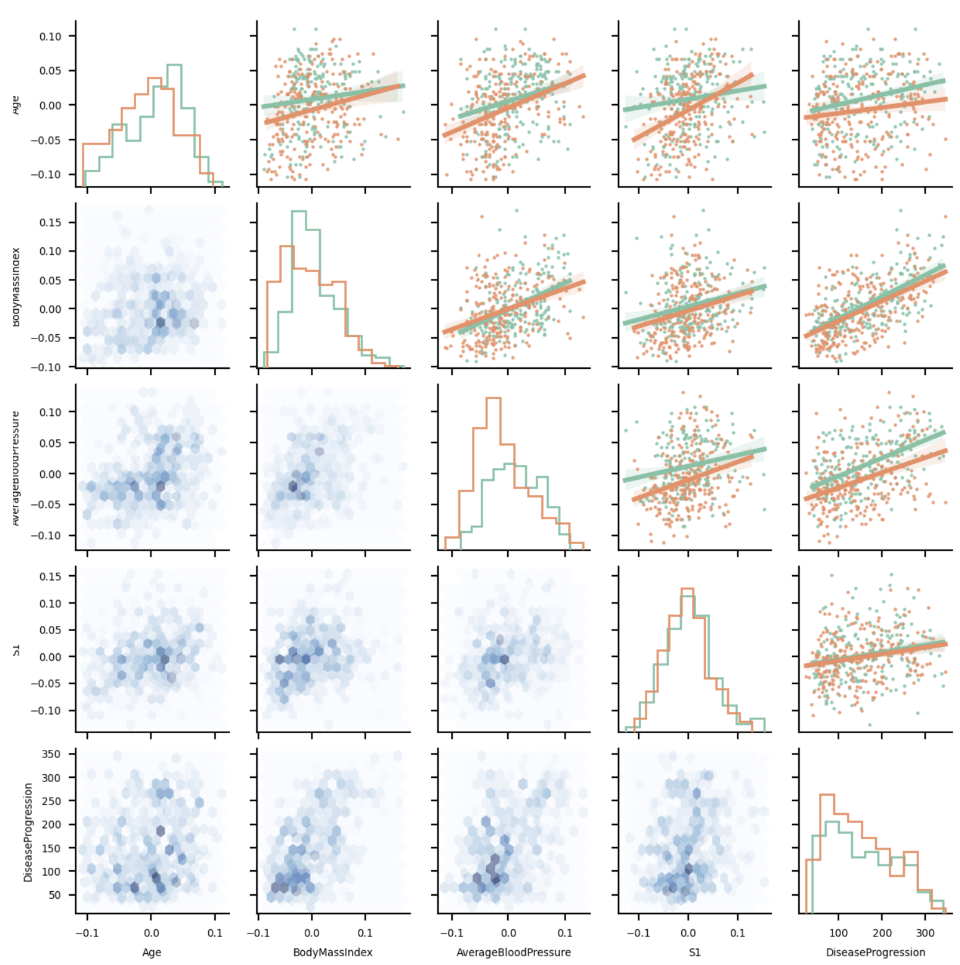
Scatter Plot Matrix
Scatter plot matrices can provide a great deal of information on the relationship of multiple variables
Scatter plot matrices are effective for comparing a small number of variables, or sets of small number of variables
Example: Using different plot types provides different views of relationships between variables
Regression scatter plot
Hexbin plot
KDE plot
Scatterplot matrix with different plot types

Slide 29
Facet Plots
Facet plots revolutionized statistical graphics starting about 30 years ago
Facet plots extend the number of dimensions projected onto 2-d plot surface
Key idea: Create array of plots of subsets of the data
Create subsets using a group-by operation on other variables
Lay out grid of plots on axes with same scale
Organize by row and column grouping variables
Display same plot type for each group
Can add specific aesthetics, etc.

Slide 30
Facet Plots
Like many good ideas facet plotting was invented several times
Multiple contemporaneous inventors and names
Tufte, 1990, introduced method of small multiples
Cleveland, 1992, introduced trellis plotting
Also known as conditioned plots
Nowadays, most packages use term facet plot

Slide 31
Facet Plot with wind speed by Month
Facet plot projected on a grid
Grid defined by variable values for row and column
Can tile or shingle numeric variables for grid
Tile categorical variables
Overlapping shingles of numeric variables
Can create variables by combinations of categories from other variables
Example: Histogram of wind speed conditioned on month
Plot grid has month in columns
Histogram of windspeed is created for each monthly subset

Slide 32
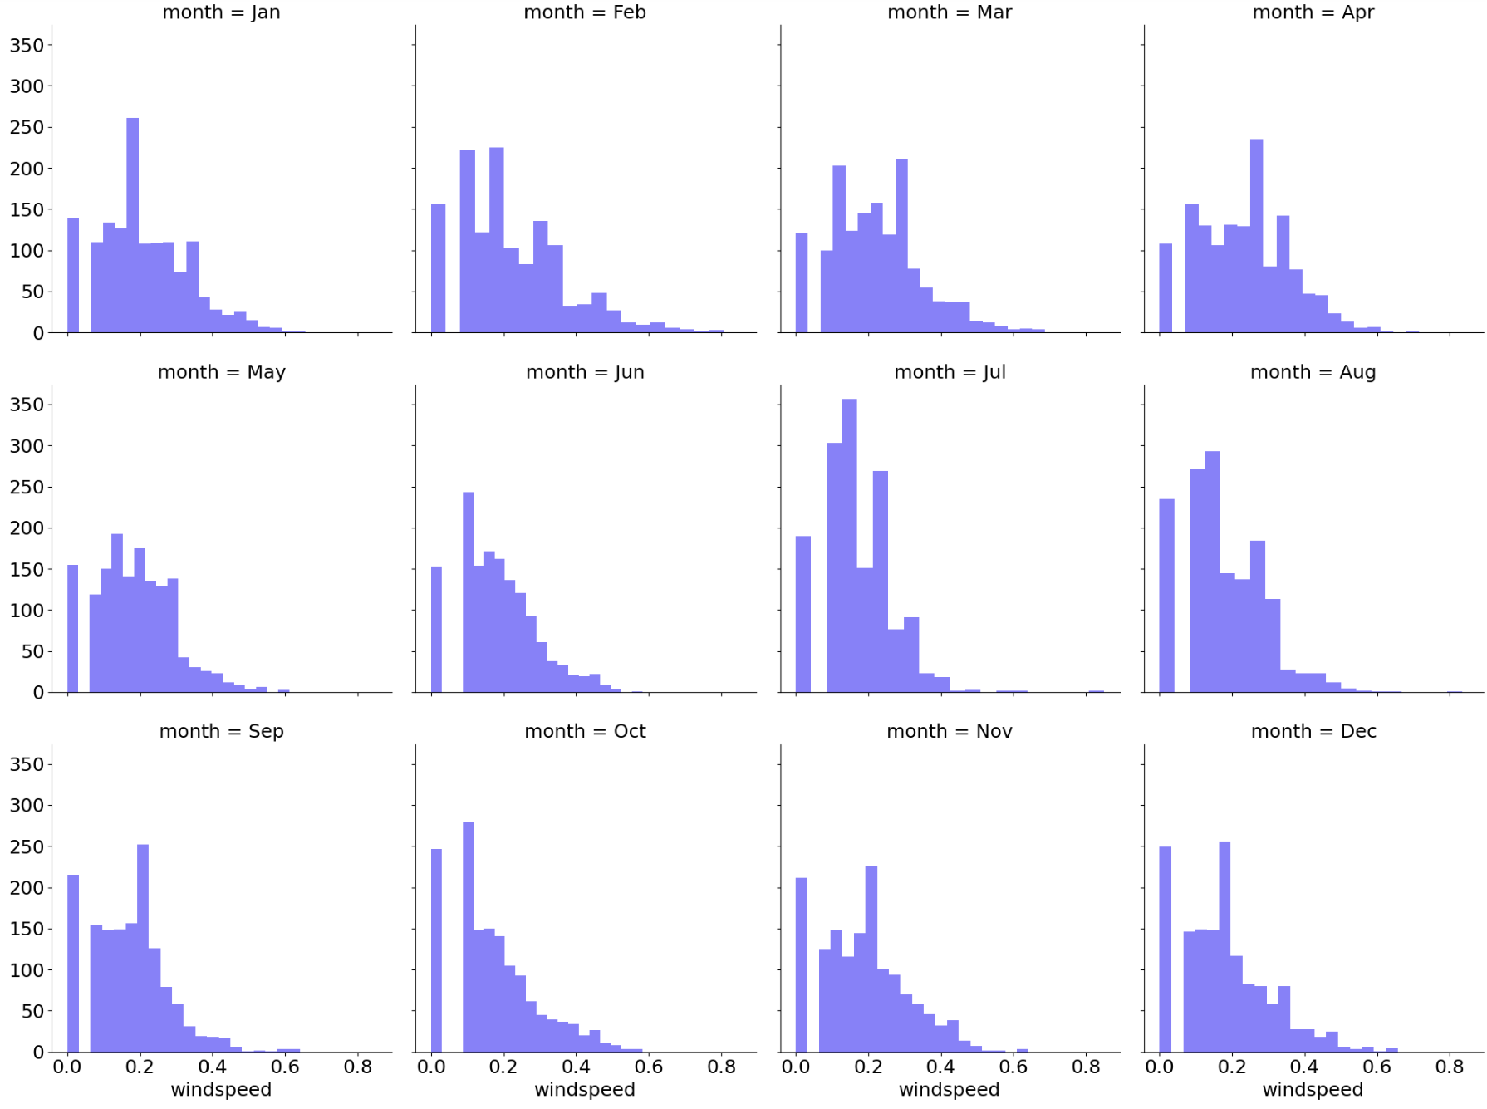
Facet Plot
Facet plots are displayed by each division (facet) of the data by other variables
Faceting can be performed on one or several variables
Axis scales are identical for each plot
Example: Histogram of wind speed variable faceted by month
Facet plot of wind by month

Slide 33
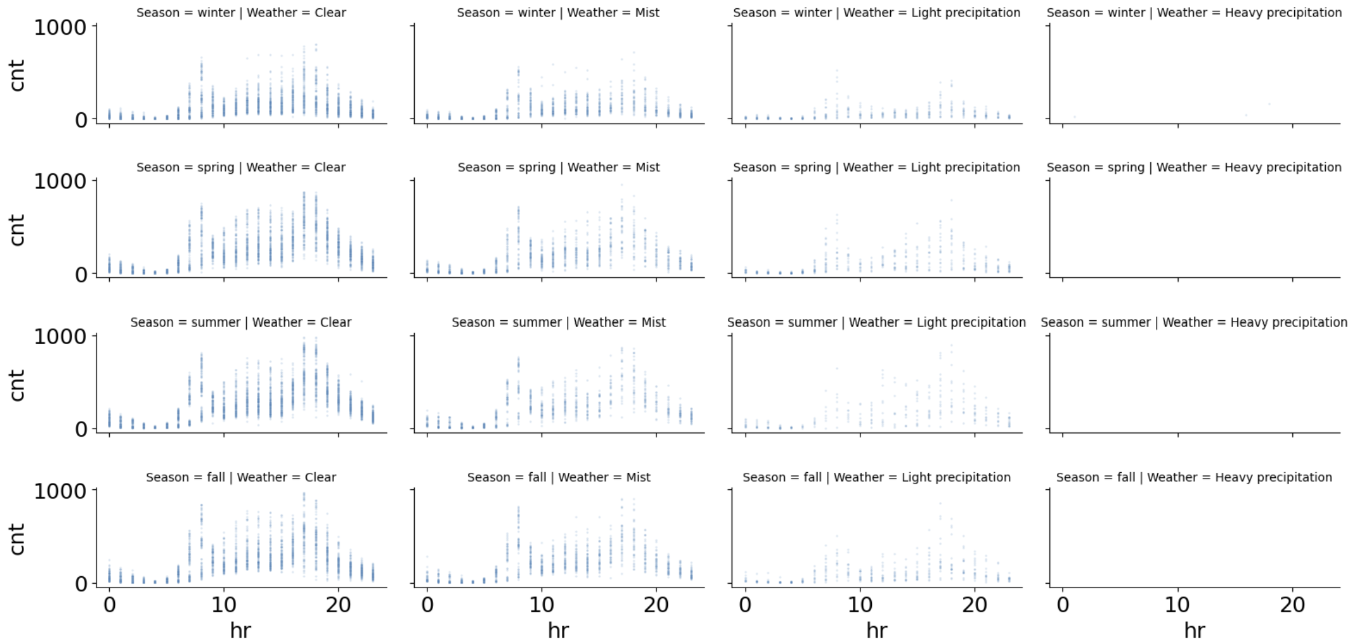
Facet Plot of Hourly Counts by Weather and Season
Example: Scatter plots of hourly rider count faceted by two variables, Season and Weather
Axis scales are identical in each plot
Notice some of the plots are nearly empty
Facet plot of count by season and weather

Slide 34
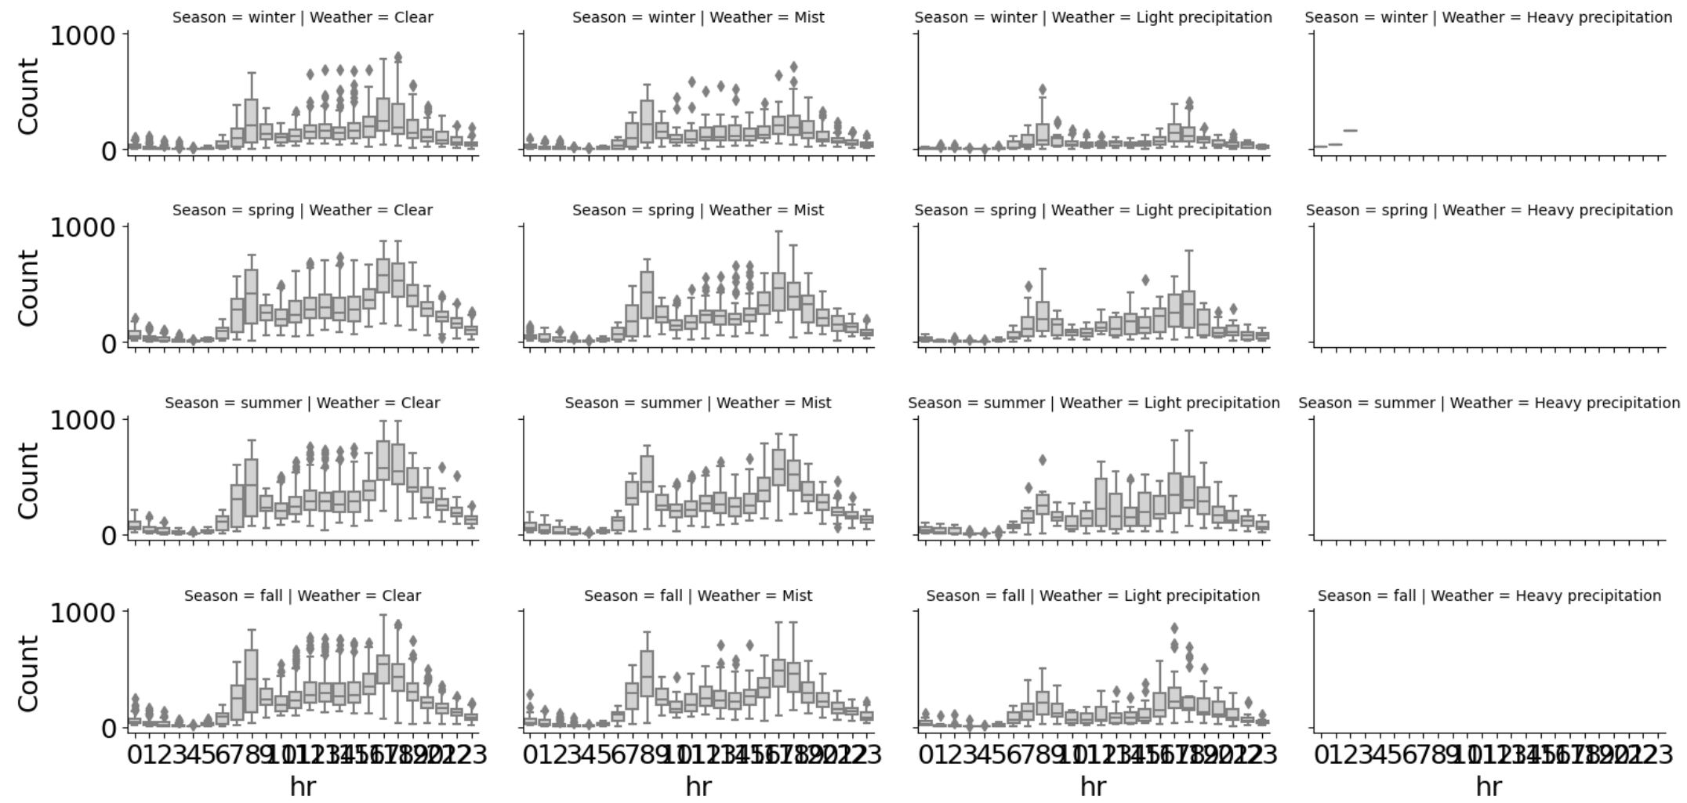
Facet Plot
Example: Box plots of hourly rider count faceted by two variables, Season and Weather
Using different plots types can give different insights into variables
Facet plot of count by season and weather

Slide 35
Congnostics
How can we visualize very high dimensional data?
Modern data sets have thousands to millions of variables
Cannot possibly look at all of these
Idea: need to find the most important relationships
Use a cognostic to sort relationship
Cognostic is a statistic to sort data
Sort the variables or relationships by the cognostic
Plot relationships with most interesting cognostic
Idea originally proposed by Tukey, 1982, 1985

Slide 36
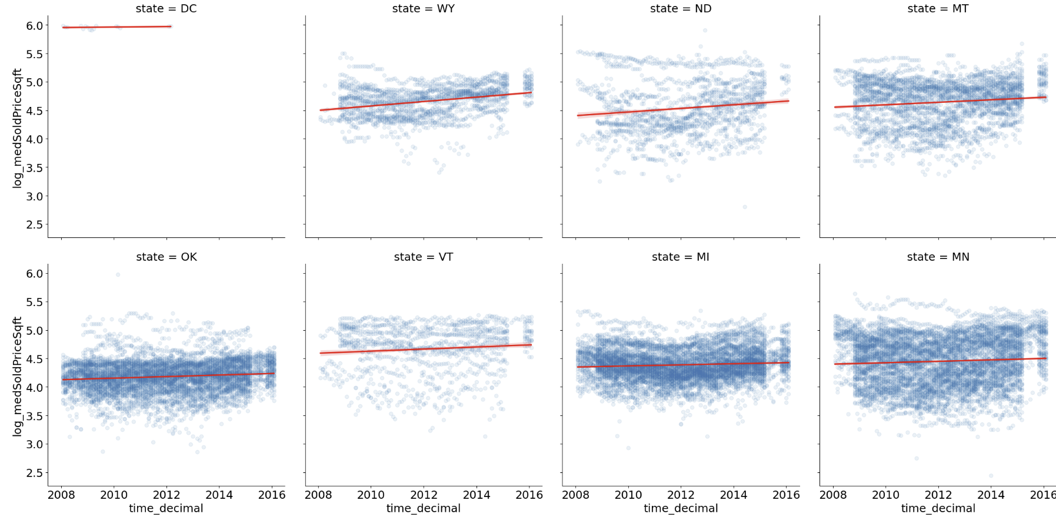
Cognistics
Cognositics sort large numbers of cases by most any statistic
Can examine most extreme cases based on cognostic
Example: Scatter plot with regression line of states with greatest rate of increase in home prices
States with greatest increase in housing price

Slide 37
Summary
We have explored these key points
Goal: Understand key relationships in large complex data sets
Difficulty: Large data volume
Modern computational systems have massive capacity
Example: Use map-reduce algorithms on cloud clusters
Difficulty: Large numbers of variables
Huge number of variables with many potential relationships
This is the hard part!

Slide 38
Summary
We have explored these key points
Proper use of plot aesthetics enable projection of multiple dimensions of complex data onto the 2-dimensional plot surface.
All plot aesthetics have limitations which must be understood to use them effectively
The effectiveness of a plot aesthetic varies with the type and the application
Visualization of modern data sets, growing in size and complexity
Visualization limited by 2-dimensional projection

Slide 39
Summary
Generally combine multiple methods to effectively display complex data
Use plots that inherently scale
Avoid over-plotting to ensure plot is understandable
Choose plot types that do not exhibit overplotting
Often a creative case specific plot type is best
Use multi-axis plots
Scatter plot matrices
Facet plots
Filter cases using cognositics

